Slide 1
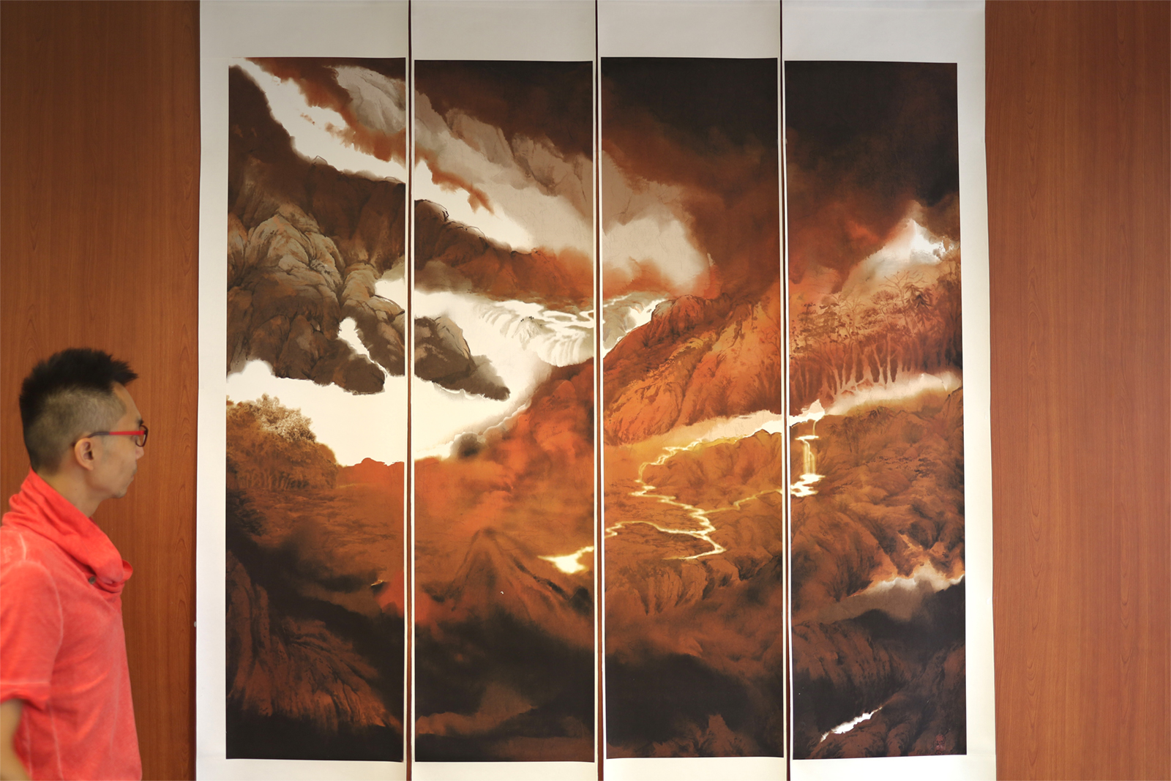
The strategy behind an artworks
How to maximize the size of your works in Pure ink

Slide 2
Target:
To minimize the size of paper in Pure ink for our target print size, and keeping the print quality as good as possible
Why:
To maximize the efficiency of our computer resources
Example:
our target print size in this example is 60cm x 120cm
The strategy behind an artworks
How to maximize the size of your works in Pure ink

Slide 3
1
Stage 1
To reduce the resolution

Slide 4
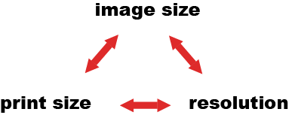
Start the thinking from the relationships between:
image size:
the size of the image on screen, counted by pixels
print size:
the print size of the image, counted by inches, cm, mm, etc
resolution
the density of pixels, dots per inch (dpi)
1

Slide 5
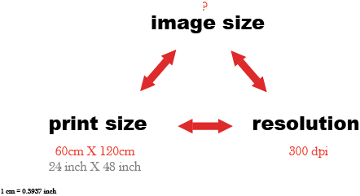
1
What will be the target image size if:
print size: 60cm x 120cm
resolution: 300 dpi

Slide 6
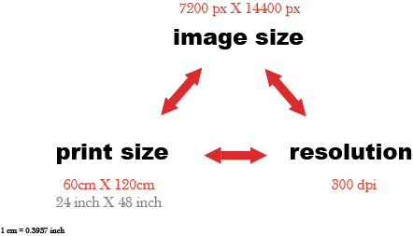
1
Target image size:
7200 px X 14400 px
Why:
(24 inch x 300 px) = 7200
(48 inch x 300 px) = 14400

Slide 7
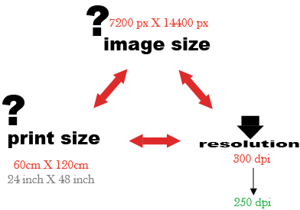
1
Strategy:
to slightly decrease the resolution to 250dpi
how will the image size and print size changes?

Slide 8
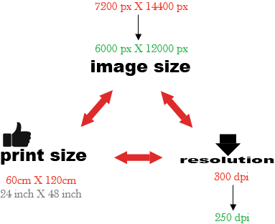
Option 1:
if we keep the print size unchanged, the image size reduces
1
Why:
(24 inch x 250 px) = 6000
(48 inch x 250 px) = 12000
Remark:
Photoshop takes this option when we reduce resolution of an image by it

Slide 9
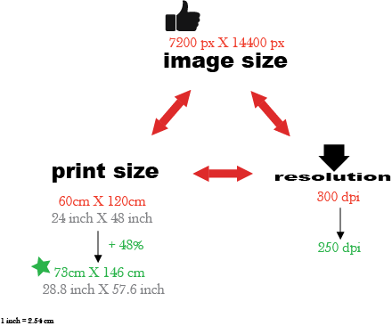
Option 2:
if we keep the image size unchanged, the print size expands
1
Why:
(7200/250) x 2.54 = 73cm
(14400/250) x 2.54 = 146cm
Advantage of option 2:
print size can be boosted up by 48%
no loss of pixels
print quality is still good

Slide 10
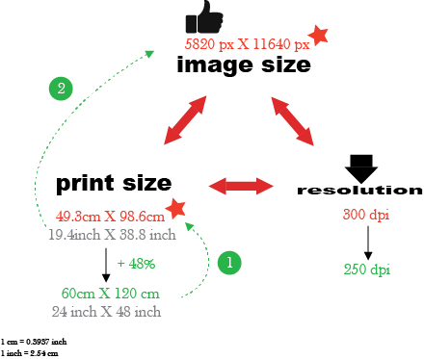
What if the final print size is 60x120cm:
We backtrack the calculation by setting the final print size as 60x120 cm
1
Backtracking 1:
remark: the ratio of 60cm:120cm is 1:2
(60x120) / 1.48 = 4864 cm²
√(4846/2) = 49.3 cm (or 19.4 inch)
49.3 x 2 = 98.6 cm (or 38.8 inch)
Backtracking 2:
remark: the resolution of the print size before
expanding is 300dpi
19.4 x 300 = 5820 px
38.8 x 300 = 11640 px

Slide 11
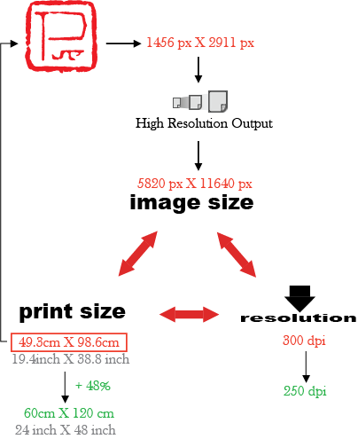
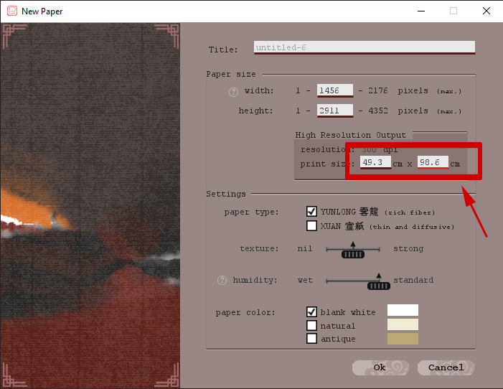
The setting in Pure ink:
by inputting 49.3x98.6 cm in Pure ink as print size, the corresponding paper size is 1456 px x 2911 px
1
High-resolution output in Pure ink:
By high-resolution output, the final size of image will be boosted up to 5820x11640 px, in 300dpi
This meets the need to prepare a print size of 60x120 cm by resolution reduction.

Slide 12
2
Stage 2
To further expand the print size

Slide 13
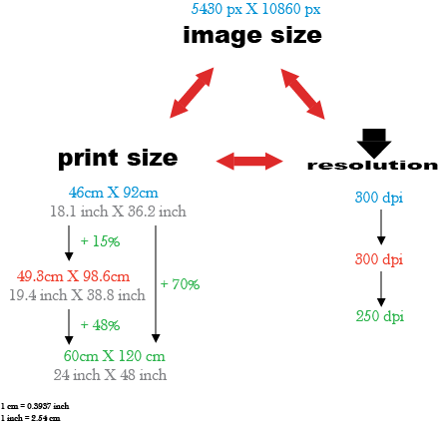
Strategy:
to slightly enlarge the print size under resolution of 300dpi (e.g. by Photoshop)
2
Example:
the initial print size can further reduced to 46x92 cm after 15% enlargement
Why:
remark: the ratio of 60cm:120cm is 1:2
(49.3x98.6)/1.15 = 4223 cm²
√(4223/2) = 46 cm
46 x 2 = 92 cm

Slide 14
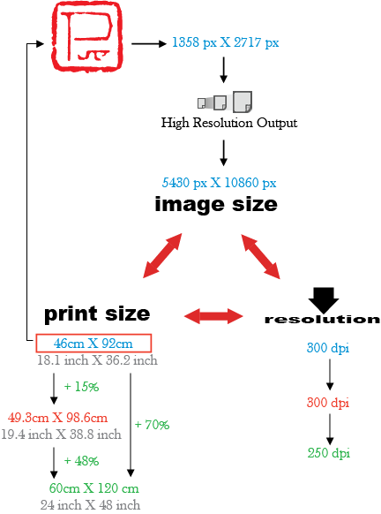
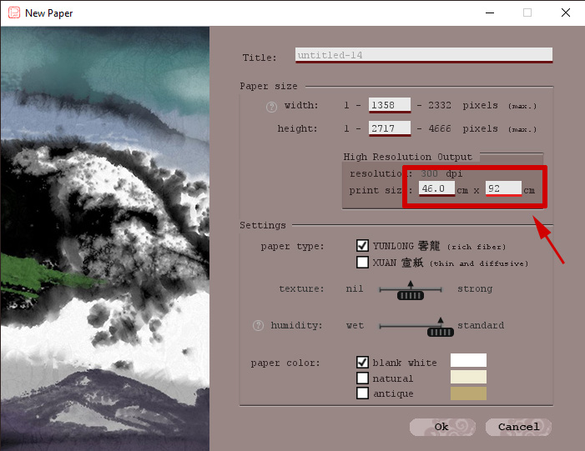
The setting in Pure ink:
by inputting 46x92 cm in Pure ink as print size, the corresponding paper size is 1358 px x 2717 px
2
Improvement:
the paper size can be further reduced, compared with stage 1

Slide 15
2
Remark:
after high resolution output from Pure ink, we enlarge the image by Photoshop (or by other software) first before doing stage 1 to reduce its resolution
print quality is not obviously affected
print size is eventually boosted up by 70%

Slide 16
2
Remark:
this approach makes the details of your work loose
to enrich the details before taking this approach

Slide 17
3
Stage 3
To puzzle two to four paintings as one work

Slide 18
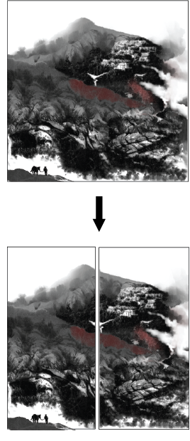
Strategy:
to greatly reduce the image size by the idea of painting puzzling (併畫)
3
How:
to separate the paper size from stage 2 (or from stage 1) by two to four.
they are painted separately and combined as one single work finally

Slide 19
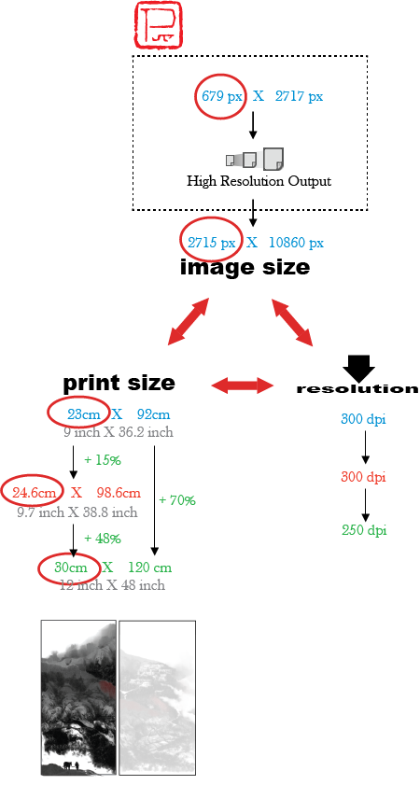
3
Example:
we separate the Pure ink paper in stage 2 by two.
each of which is 679 x 2717 px. Its print size can be eventually boosted up to 30cm x 120cm
They are combined to form a single work meeting the need of our target print size: 60x120 cm

